Slide 1

Problem Statement
Analyze Health and Demographic Data to identify common traits leading to Heart Disease
Notes:
Line spacing + Page numbers

Slide 2
Agenda
01 Research Report
02 Cleaning Data
03 EDA
04 Visualization
05 Key Findings
06 Conclusions

Slide 3
Scope of Work
In this project, we are working with a large dataset that includes health records from a wide population.
Our task is to clean the data, analyze it, and identify the factors most strongly associated with heart disease.
The process includes:
Data cleaning to ensure accuracy.
Exploratory Data Analysis (EDA) to explore the data.
Applying predictive models to find key risk factors.
Presenting insights through visualizations.

Slide 4


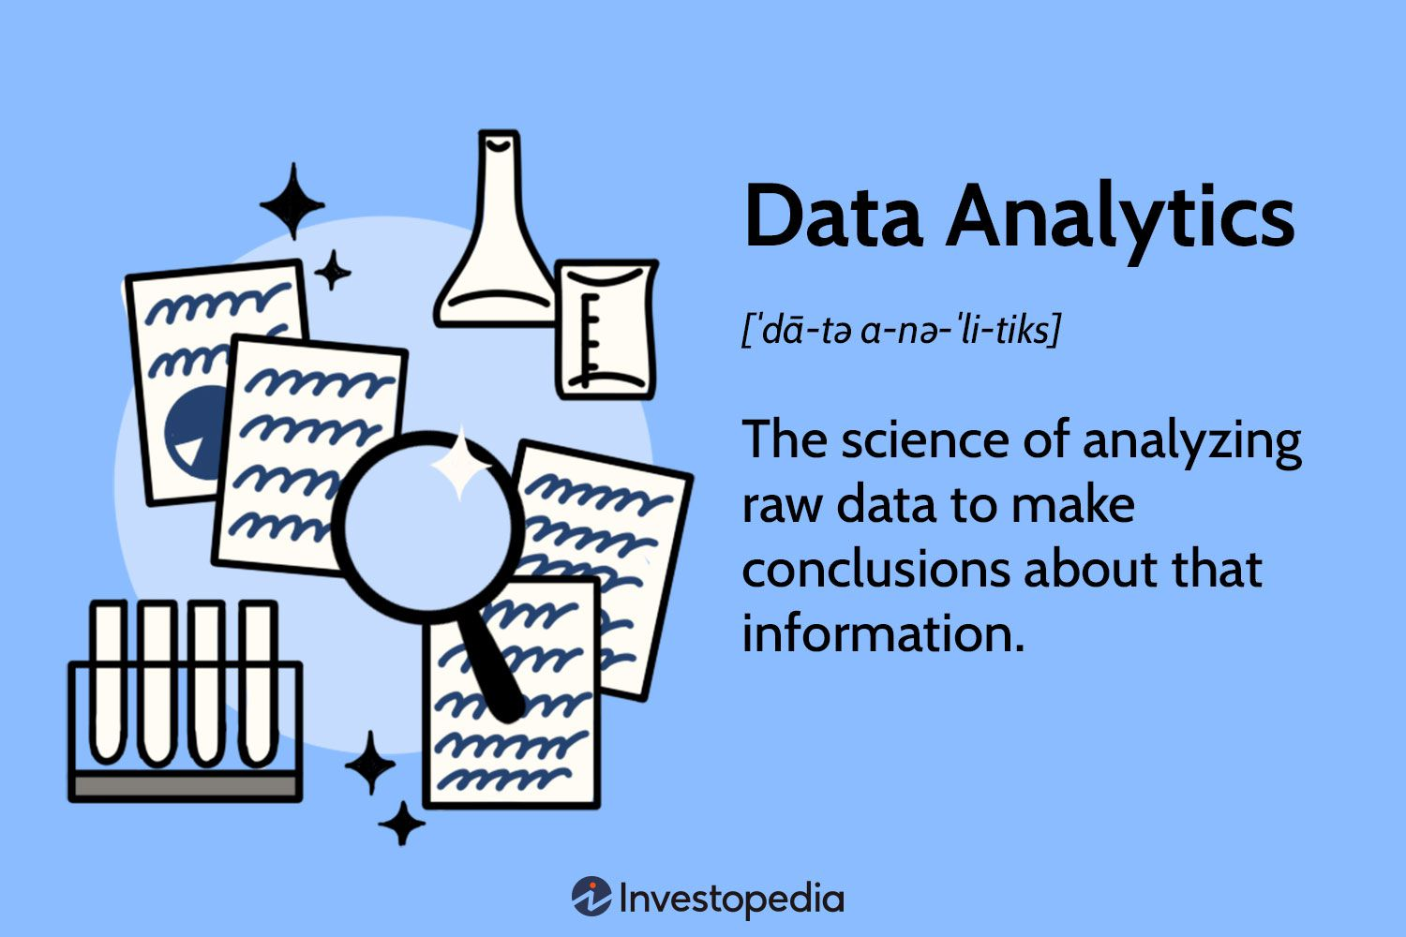
Research Report
01
The Role of Analytics in the Healthcare Sector
Significance of Data Analytics in Healthcare
Trends and Tools in Healthcare Analytics

Slide 6
The Role of Analytics in the Healthcare Sector
Predictive Modelling:
Identifies high-risk patients for early intervention.
Reduces hospital readmissions and healthcare costs.
2. Improving Care Quality & Outcomes:
Analyzes treatment data to standardize care protocols.
Enhances patient safety by identifying medical errors and drug interactions.
3. Operational Efficiency & Cost Management:
Optimizes staffing, reduces wait times, and improves patient flow.
Identifies inefficiencies to cut costs without compromising care.

Slide 7
The Role of Analytics in the Healthcare Sector
4. Personalized Medicine:
Uses genetic and clinical data to tailor treatments for individuals.
Improves treatment effectiveness and reduces side effects.
5. Public Health Management:
Tracks disease outbreaks and health trends.
Supports targeted interventions during health crises like COVID-19.

Slide 8
Significance of Data Analytics in Healthcare
1. Improved Health Predictions:
Predicts potential health issues for early intervention.
Reduces hospital admissions and healthcare costs.
2. Enhanced Treatment Plans:
Analyzes data to develop effective, evidence-based treatments.
Ensures patients receive the right care for their conditions.
3. Operational Efficiency:
Optimizes staff levels and reduces wait times.
Enhances hospital workflows and patient experience.
4. Personalized Medicine:
Tailors treatments based on individual genetic data.
Improves treatment outcomes with fewer side effects.
Disease Tracking:
Monitors disease trends and health crises, like COVID-19.
Informs public health responses and interventions.

Slide 9
Trends and Tools in Healthcare Analytics
Trends refer to the latest advancements and practices shaping how data is used in healthcare.
Tools are the software, platforms, and technologies that healthcare professionals use to collect, analyze, and visualize data.

Slide 10
Trends and Tools in Healthcare Analytics
03
Machine Learning and Artificial Intelligence
Electronic Health Records (EHR) Analytics
Internet of Medical Things (IoMT)
Data Visualization
Tools: TensorFlow, scikit-learn, H2O.ai
Application: Developing predictive models for heart disease risk assessment based on patient data.
Tools: Epic Systems, Cerner, MEDITECH
Application: Analyzing patient history and clinical data to identify patterns and risk factors for heart disease.
Tools: Wearable devices (e.g., Apple Watch, Fitbit), connected medical devices
Application: Continuous monitoring of vital signs and early detection of heart-related issues.
Tools: Tableau, Power BI, D3.js
Application: Creating interactive dashboards to visualize heart disease trends and risk factors across populations.

Slide 11

Cleaning data

Slide 12
Process of Cleaning Data
Aug
1
2
3
4
Remove Duplicate Data
Validate Data Types
Handle Missing Data
Handle Inconsistent Data

Slide 13
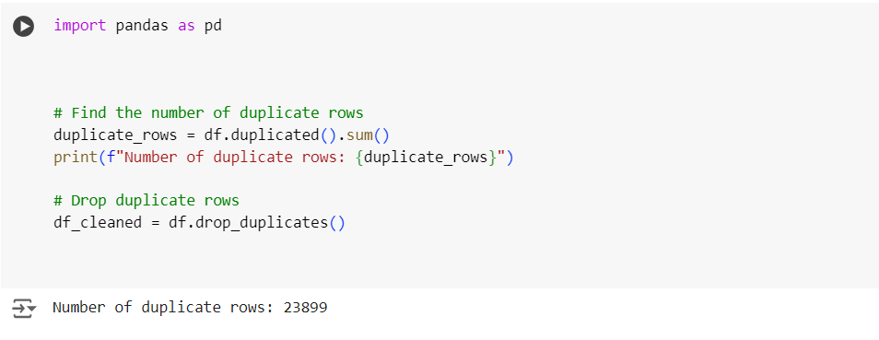
Cleaning data
Finding Duplicate rows

Slide 14
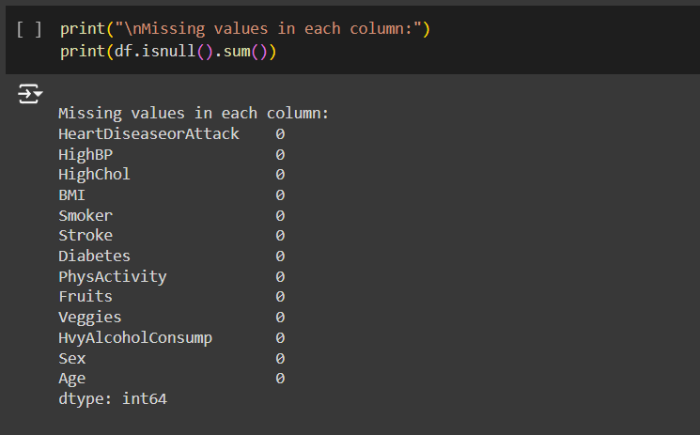
Cleaning data
Finding Null Values

Slide 15
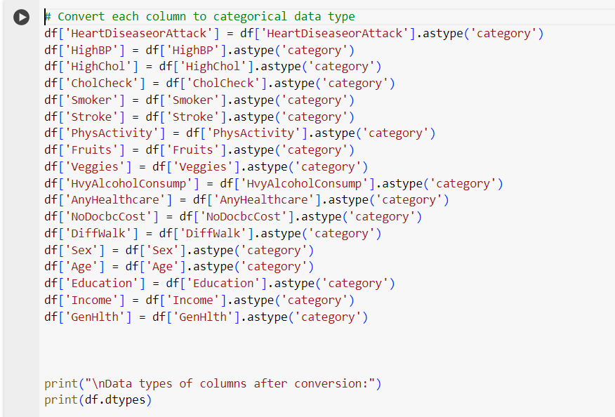
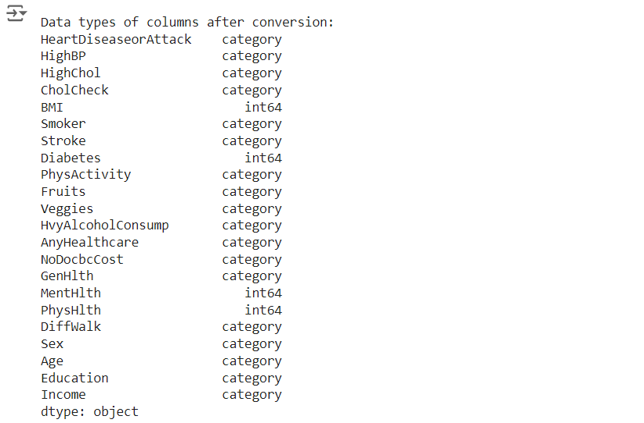
Cleaning data
Data Types of Features

Slide 16
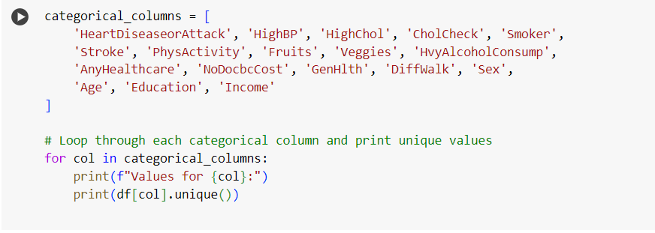
Cleaning data
Handle Inconsistent Data

Slide 17
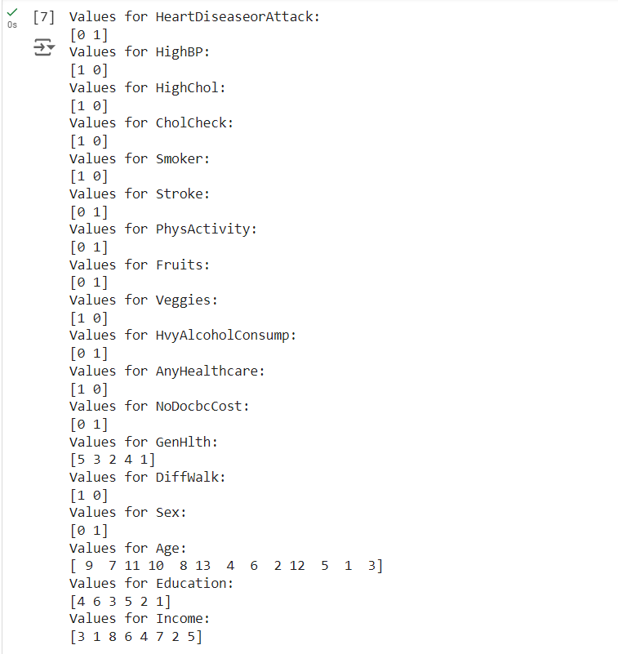
Cleaning data
Handle Inconsistent Data

Slide 18
Cleaning Data

Slide 19
EDA
03

Slide 20
EDA
This process involves
Explore the Dataset
Data Analysis: Univariate
Data Analysis: Bivariate

Slide 21
EDA
Understand the available variables
HeartDiseaseorAttack
HighBP
HighChol
CholCheck
BMI
Smoker
Stroke
Diabetes
PhysActivity
Fruits
Veggies
12. HvyAlcoholConsump
13. AnyHealthcare
14. NoDocbcCost
15. GenHlth
16. MentHlth
17. PhysHlth
18. DiffWalk
19. Sex
20. Age
21. Education
22. Income

Slide 22
Data Analysis: Univariate
Examine Distributions of Individual Variables
Investigate Prevalence of Health Conditions
Analyze Distribution of Heart Disease (Target Variable)

Slide 23
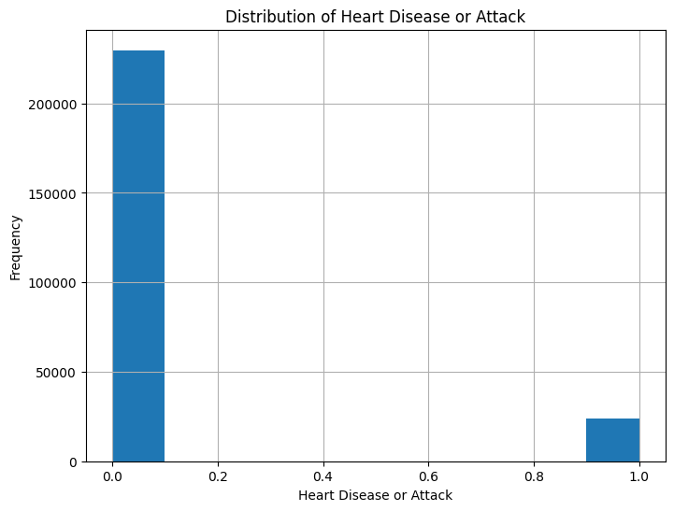
Univariate
Key Variables are
HeartDiseaseorAttack
HighBP
HighChol
BMI
Smoker
Stroke
Examine Distributions of Individual Variables

Slide 24
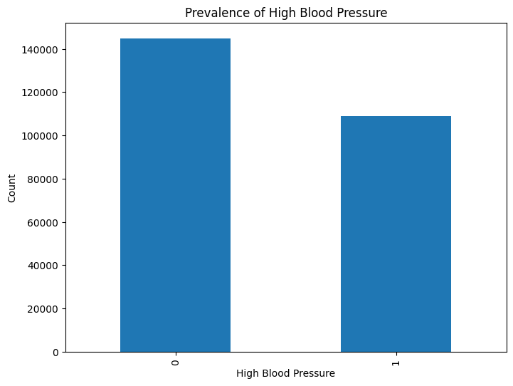
Univariate
Key Variables are
HeartDiseaseorAttack
HighBP
HighChol
BMI
Smoker
Stroke
Examine Distributions of Individual Variables

Slide 25
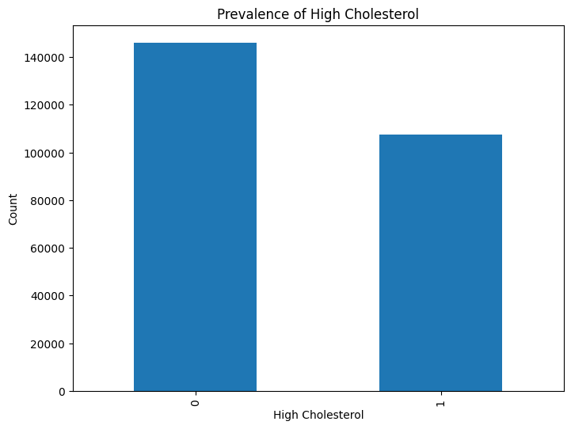
Univariate
Key Variables are
HeartDiseaseorAttack
HighBP
HighChol
BMI
Smoker
Stroke
Examine Distributions of Individual Variables

Slide 26
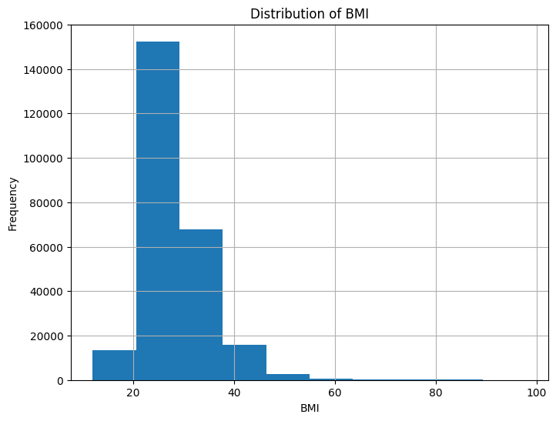
Univariate
Key Variables are
HeartDiseaseorAttack
HighBP
HighChol
BMI
Smoker
Stroke
Examine Distributions of Individual Variables

Slide 27
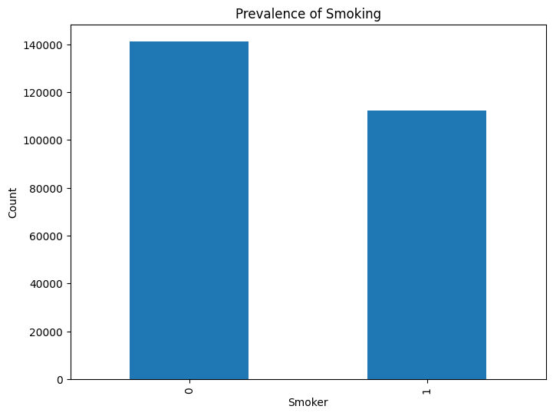
Univariate
Key Variables are
HeartDiseaseorAttack
HighBP
HighChol
BMI
Smoker
Stroke
Examine Distributions of Individual Variables

Slide 28
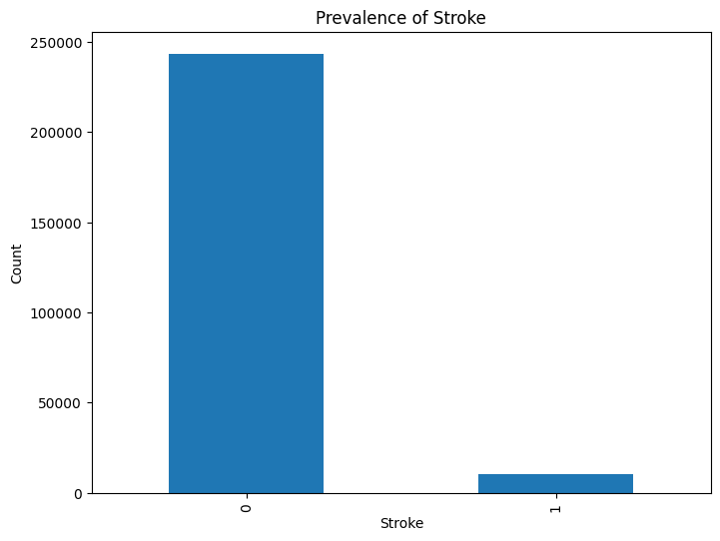
Univariate
Key Variables are
HeartDiseaseorAttack
HighBP
HighChol
BMI
Smoker
Stroke
Examine Distributions of Individual Variables

Slide 29
Univariate
Key Variables are
HeartDiseaseorAttack
HighBP
HighChol
BMI
Smoker
Stroke
Examine Distributions of Individual Variables
Heart Disease: There are many more people without heart disease than with it. This might need special attention when analyzing or building models.
High Blood Pressure: More people have high blood pressure than don't, though the numbers are fairly close. It's a common condition in this dataset.
High Cholesterol: Many people have high cholesterol, almost as many as those with high blood pressure. Both issues are quite common.
Smoking: There are more non-smokers than smokers in the dataset. Although smoking is a major risk factor, non-smokers are more common here.
BMI: Most people have a BMI between 20 and 30. There are also many people in the overweight and obese ranges, which might be important.
Stroke: Strokes are rare in this dataset, which could affect how important they are in predictions and analysis.

Slide 30
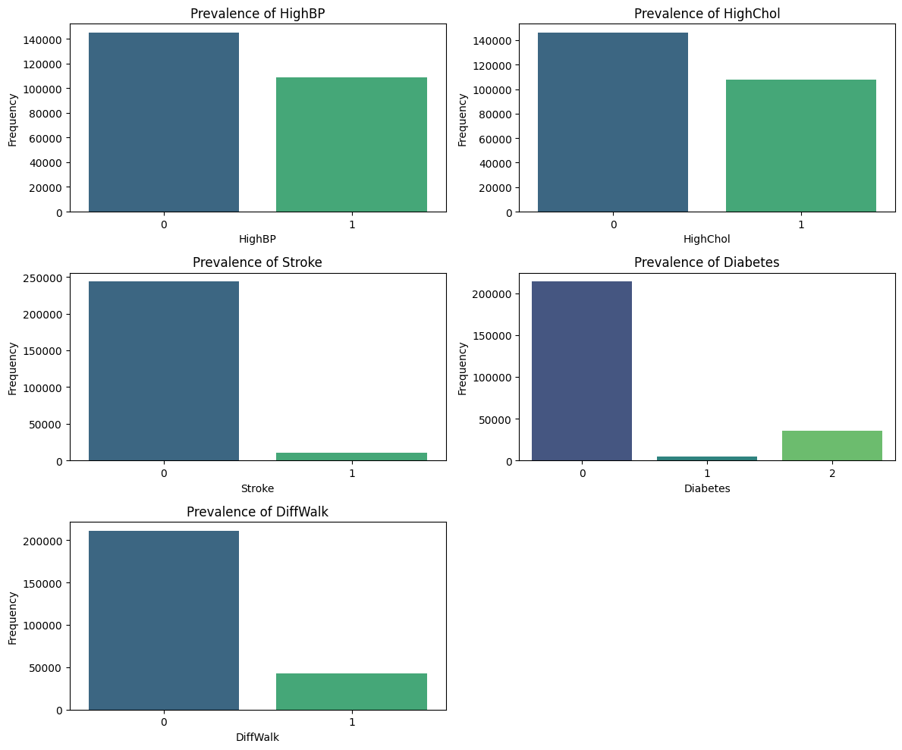
Univariate
Variables considered:
HighBP
HighChol
Stroke
Diabetes
DiffWalk
Investigate Prevalence of Health Conditions

Slide 31
Univariate
Variables considered:
HighBP
HighChol
Stroke
Diabetes
DiffWalk
Investigate Prevalence of Health Conditions

Slide 32
Univariate
Variables considered:
HighBP
HighChol
Stroke
Diabetes
DiffWalk
Investigate Prevalence of Health Conditions

Slide 33
Univariate
Variables considered:
HighBP
HighChol
Stroke
Diabetes
DiffWalk
Investigate Prevalence of Health Conditions

Slide 34
Univariate
Variables considered:
HighBP
HighChol
Stroke
Diabetes
DiffWalk
Investigate Prevalence of Health Conditions

Slide 35
Univariate
Variables considered:
HighBP
HighChol
Stroke
Diabetes
DiffWalk
Investigate Prevalence of Health Conditions
High blood pressure is very prevalent, affecting nearly half of the population.
High cholesterol is also common, affecting over 40% of individuals.
Stroke is relatively rare in this population. This lower prevalence suggests that while strokes are a serious health issue, they are less common compared to other conditions.
Type 2 diabetes is a significant condition among those affected.
Difficulty Walking condition affects a smaller portion of the population compared to the more common health issues like high blood pressure and high cholesterol. This could be related to various health issues or age-related factors.

Slide 36
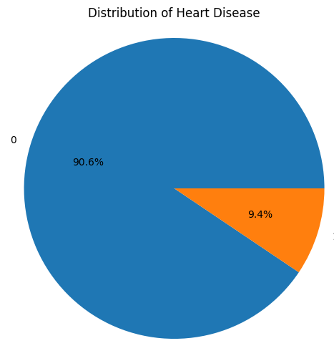
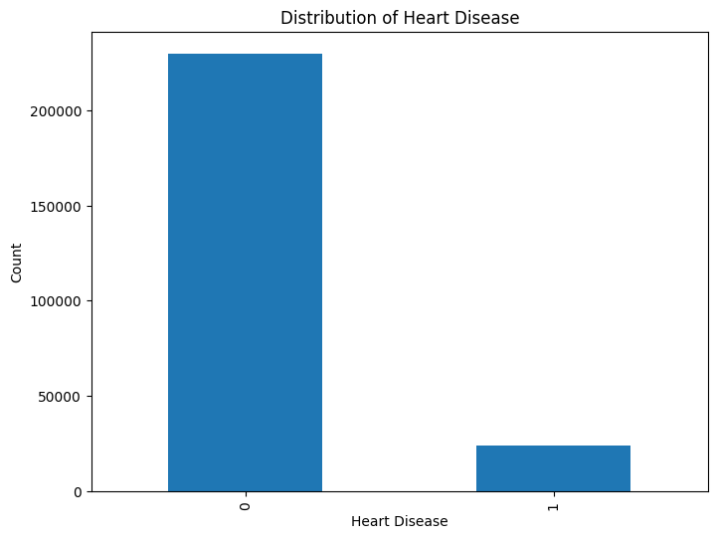
Univariate
Analyze Distribution of Heart Disease (Target Variable)
Heart disease affects around 9.4% of the population in the dataset.
This suggests that while heart disease is a critical condition, the majority of individuals (about 90.6%) do not report having heart disease.

Slide 37
Data Analysis: Bivariate
Explore Relationships with Heart Disease
Visualize Correlations Between Variables
Compare Heart Disease Across Demographic Groups

Slide 38
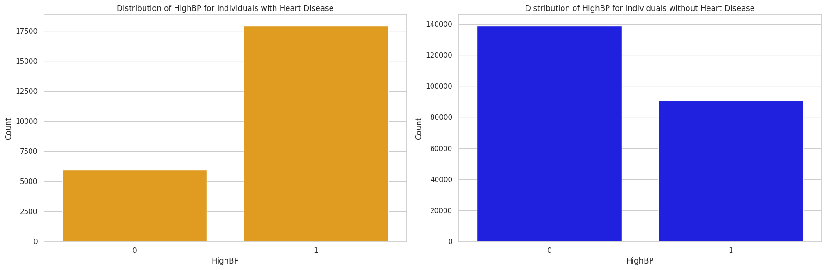
Bivariate
Distribution Of High Blood Pressure Of Individuals With And Without Heart Disease.

Slide 39
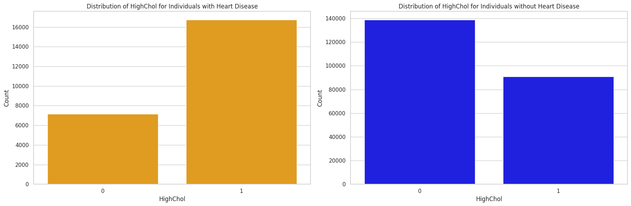
Bivariate
Distribution Of High Blood Pressure Of Individuals With And Without Heart Disease.

Slide 40
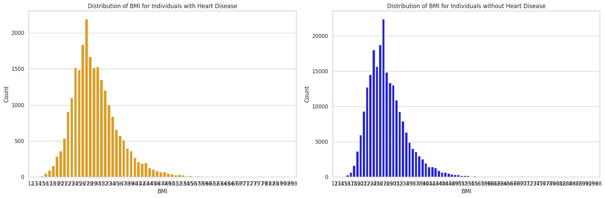
Bivariate
Distribution Of High Blood Pressure Of Individuals With And Without Heart Disease.

Slide 41
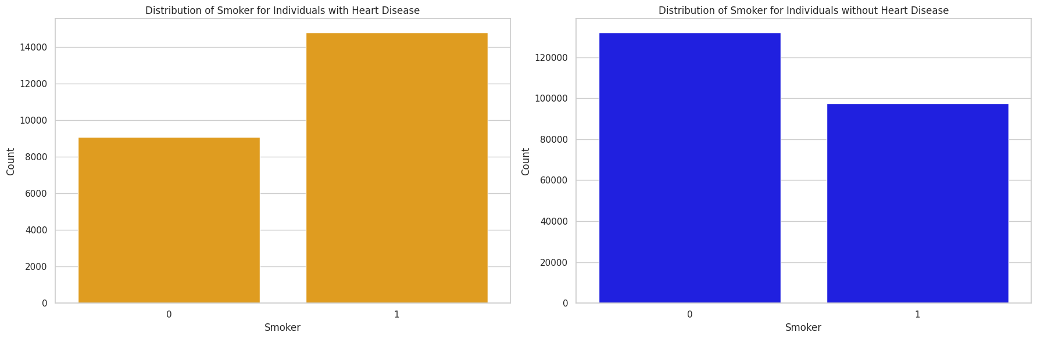
Bivariate
Distribution Of High Blood Pressure Of Individuals With And Without Heart Disease.

Slide 42
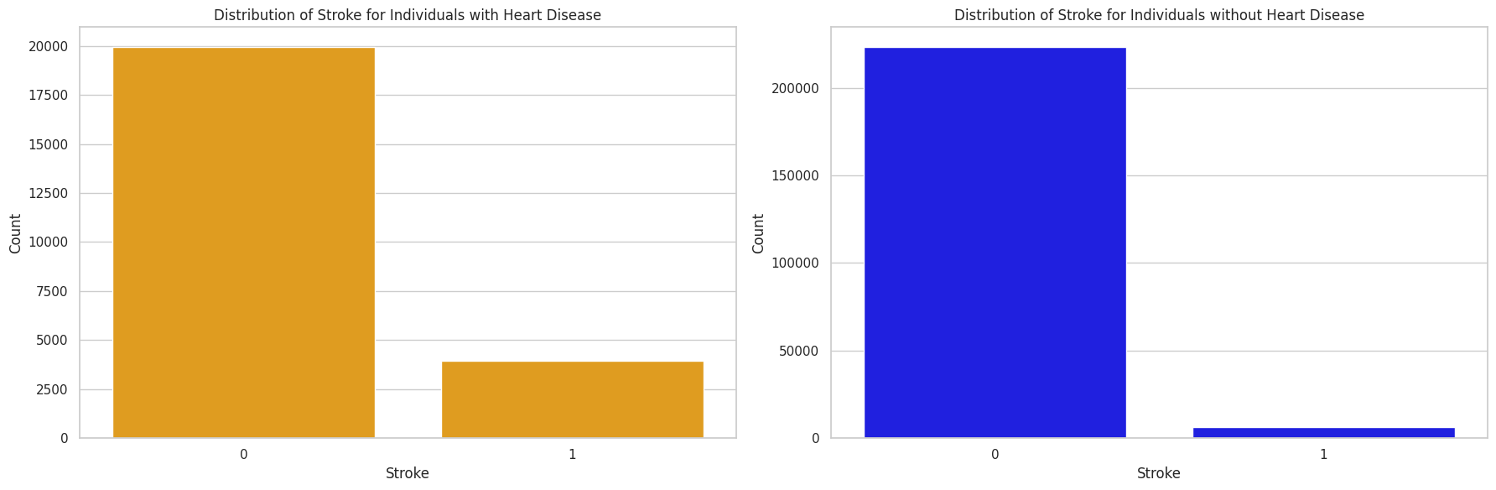
Bivariate
Distribution Of High Blood Pressure Of Individuals With And Without Heart Disease.

Slide 43
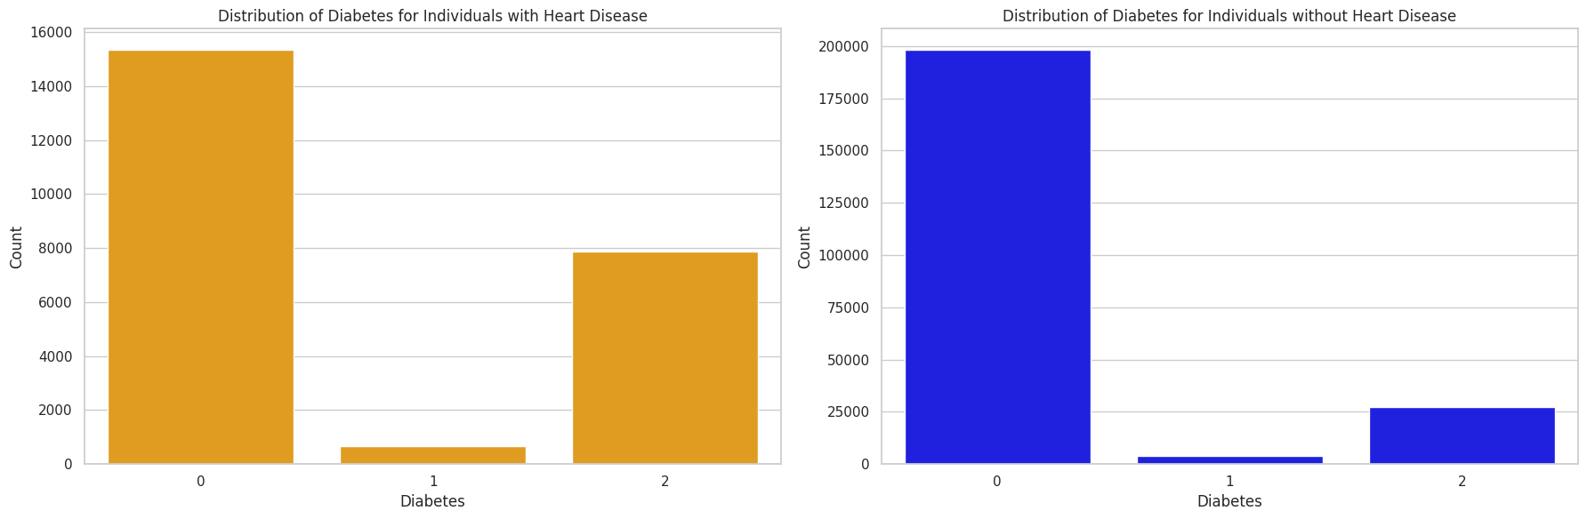
Bivariate
Distribution Of High Blood Pressure Of Individuals With And Without Heart Disease.

Slide 44
Bivariate
Compare the distribution of key variables between individuals with and without heart disease.
Key variables considered are
High Blood Pressure
High Cholesterol
Smoking
Stroke
Body Mass Index
1. Strong risk factors for heart disease:
High blood pressure (75.03% in heart disease group vs 39.56% in non-heart disease group)
High cholesterol
Smoking
History of stroke
Higher Body Mass Index (BMI)
2. Statistical significance:
All identified risk factors show strong statistical associations with heart disease (extremely low p-values)

Slide 45
Bivariate
Key variables considered are
High Blood Pressure
High Cholesterol
Smoking
Stroke
Body Mass Index
Compare the distribution of key variables between individuals with and without heart disease.
3. Prevalence patterns:
These risk factors are consistently more prevalent among individuals with heart disease compared to those without
4. Implications:
Individuals with these risk factors have a significantly higher likelihood of developing heart disease
Managing these factors could potentially reduce heart disease risk
5. Importance of BMI:
The extremely low p-value for BMI suggests it's a particularly significant risk factor

Slide 46
Bivariate
Distribution Of High Blood Pressure Of Individuals With And Without Heart Disease.
High Blood Pressure: Many people with heart disease also have high blood pressure, showing it's a key risk factor for heart disease.
High Cholesterol: High cholesterol is common among those with heart disease, making it another important risk factor.
BMI: Although BMI values are similar between those with and without heart disease, higher BMI values might suggest a higher risk of heart disease.
Smoking: Smoking is more frequent in people with heart disease, highlighting its strong link to cardiovascular problems.
Stroke: There is a significant connection between heart disease and stroke, indicating they often occur together.
Diabetes: Type 2 diabetes is more common in people with heart disease, confirming it as an important risk factor.

Slide 47
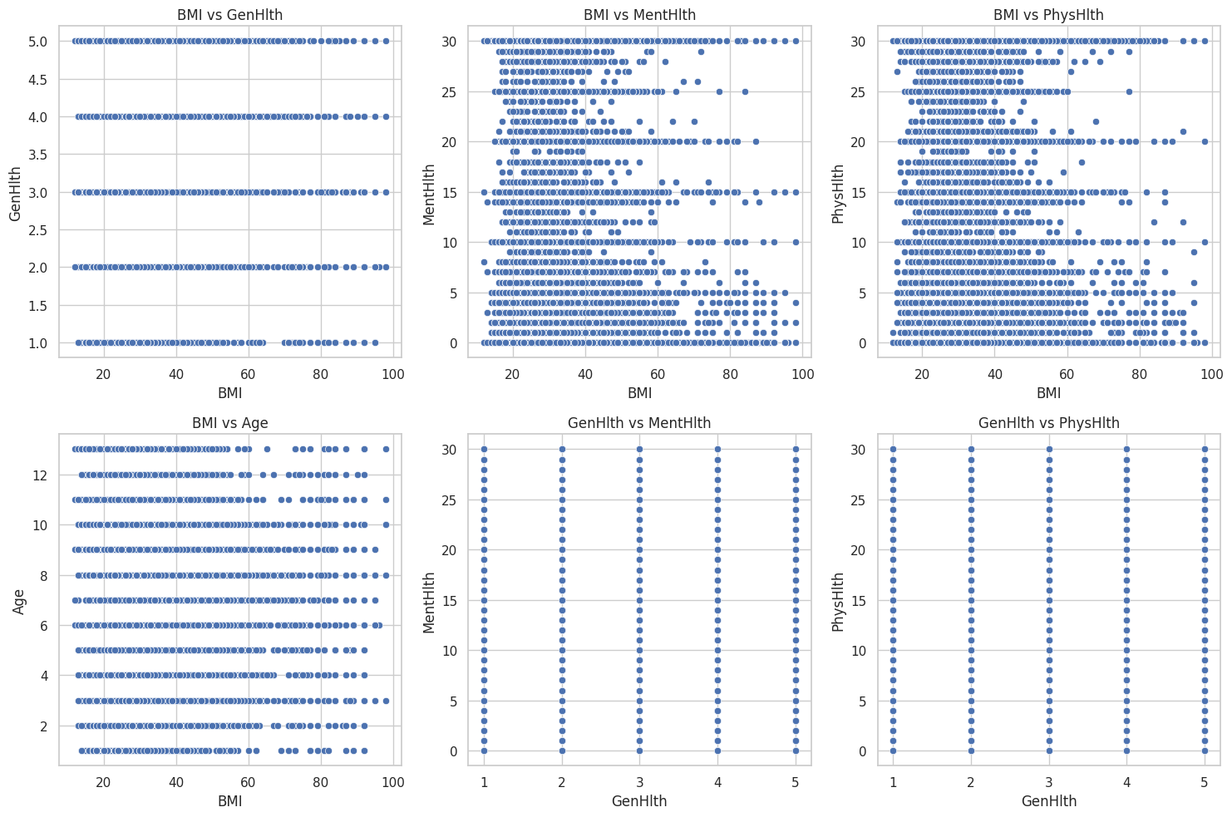
Bivariate
Visualize Correlations Between Variables

Slide 48
Bivariate
Visualize Correlations Between Variables

Slide 49
Bivariate
Visualize Correlations Between Variables

Slide 50
Bivariate
Visualize Correlations Between Variables

Slide 51
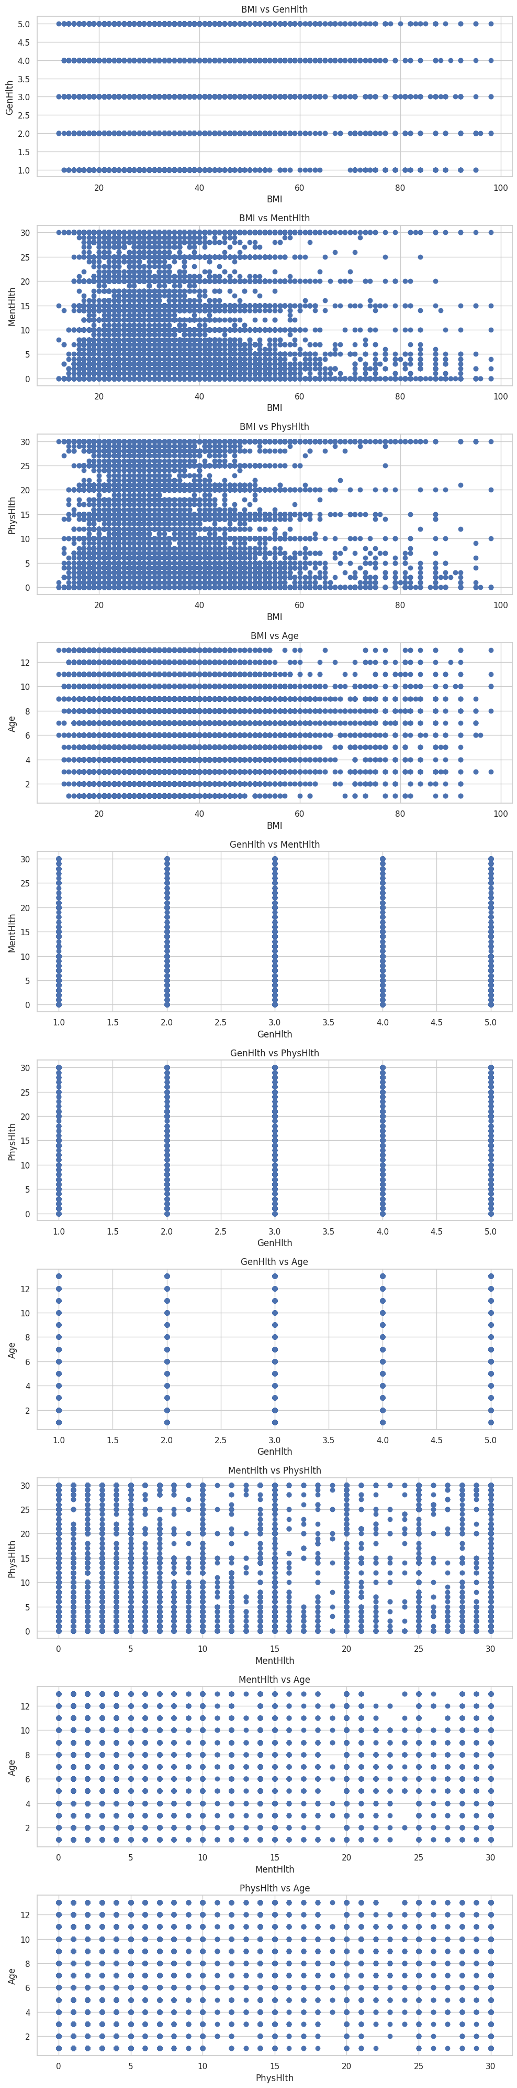
Bivariate
Visualize Correlations Between Variables

Slide 52
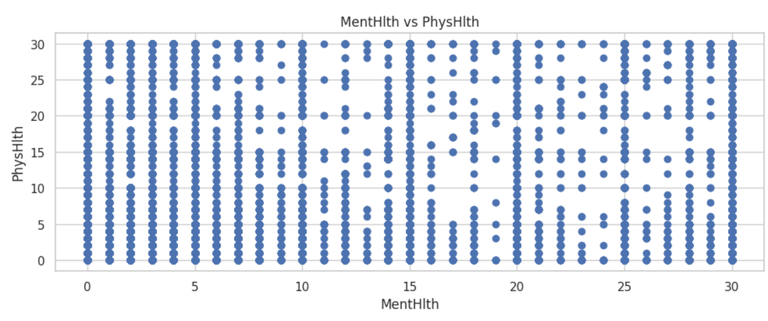
Bivariate
Visualize Correlations Between Variables

Slide 53
Bivariate
Visualize Correlations Between Variables

Slide 54
Bivariate
Visualize Correlations Between Variables

Slide 55
Bivariate
Visualize Correlations Between Variables
BMI and General Health (GenHlth): As BMI goes up, general health tends to worsen, meaning people with higher BMI often report poorer general health.
BMI and Mental Health (MentHlth): People with higher BMI generally have slightly more days of poor mental health, though the connection is weak.
BMI and Physical Health (PhysHlth): Similar to mental health, higher BMI is associated with slightly more days of poor physical health.
BMI and Age: BMI tends to increase a little as people get older, but the relationship isn’t very strong.
General Health and Mental Health: Poor general health is moderately linked to more days of poor mental health.

Slide 56
Bivariate
Visualize Correlations Between Variables
6. General Health and Physical Health: There is a strong link between poor general health and more days of poor physical health.
7. General Health and Age: General health tends to decline slightly with age, but the link is weak.
8. Mental Health and Physical Health: More days of poor mental health are strongly related to more days of poor physical health, showing a close connection between the two.
9. Mental Health and Age: Older individuals may report a slight increase in poor mental health days, but the connection is very weak.
10. Physical Health and Age: Older people might report slightly more days of poor physical health, but the relationship is weak.

Slide 57
VISUALIZATION

Slide 58
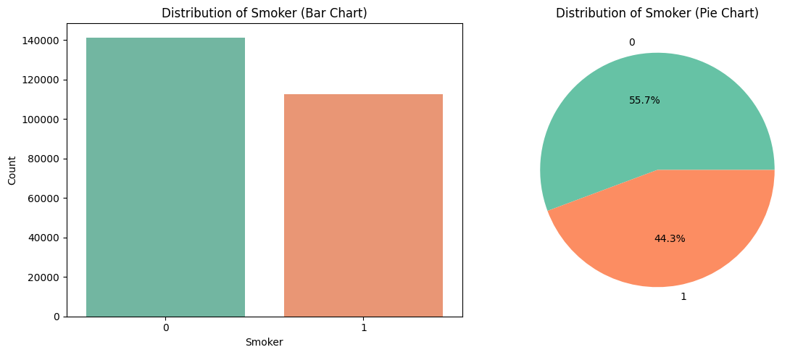
Visualize Categorical Variables
Smoking status (Smoker)

Slide 59
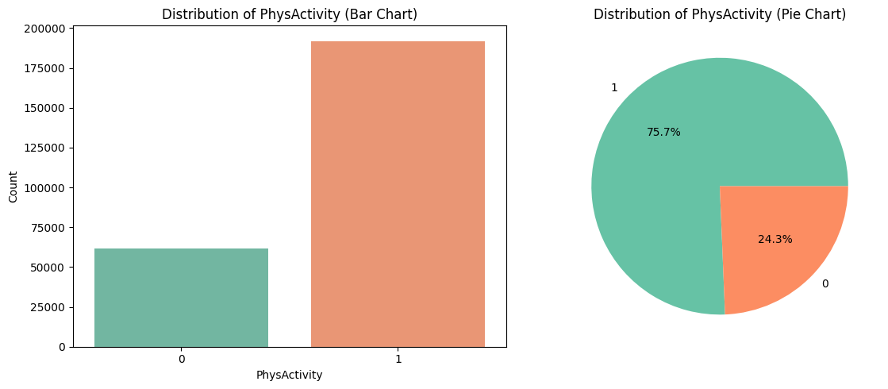
Visualize Categorical Variables
Physical activity (PhysActivity)

Slide 60
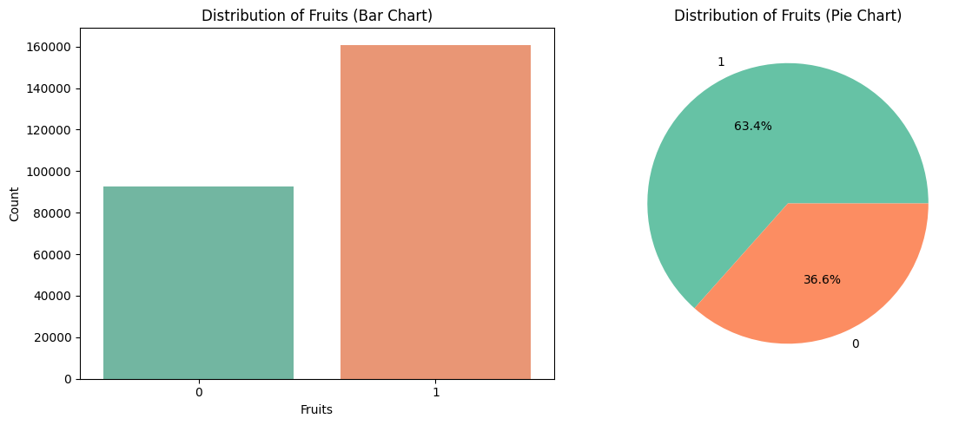
Visualize Categorical Variables
Fruit consumption (Fruits)

Slide 61
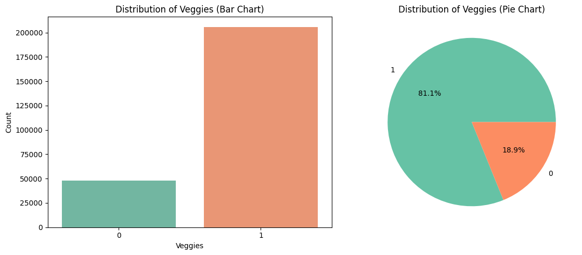
Visualize Categorical Variables
Vegetable consumption (Veggies)

Slide 62
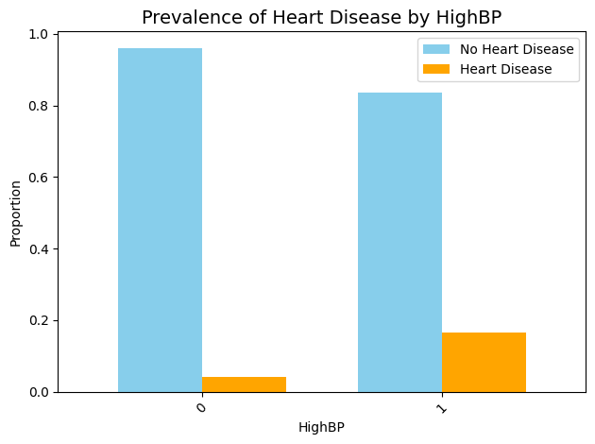
Compare Heart Disease Across Categories
Compare the prevalence of heart disease across categorical variable High BP

Slide 63
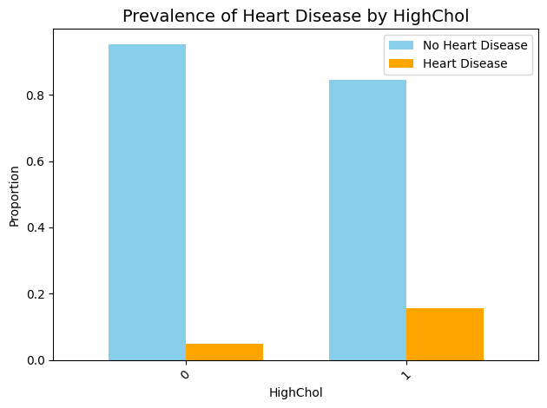
Compare Heart Disease Across Categories
Compare the prevalence of heart disease across categorical variable High Cholestrol

Slide 64
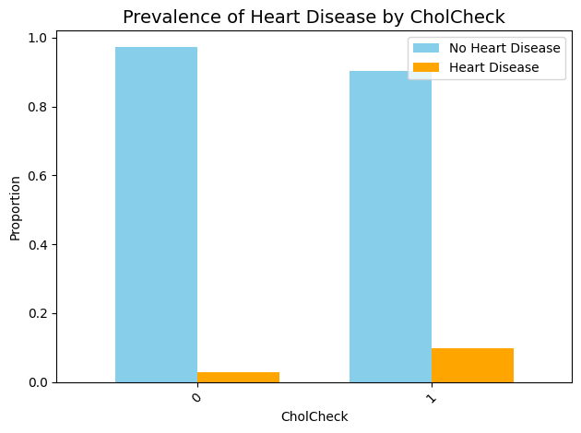
Compare Heart Disease Across Categories
Compare the prevalence of heart disease across categorical variable Stroke

Slide 65
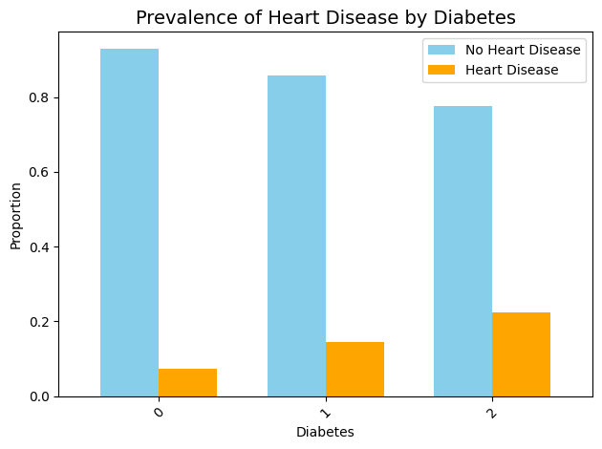
Compare Heart Disease Across Categories
Compare the prevalence of heart disease across categorical variable Diabetes

Slide 66
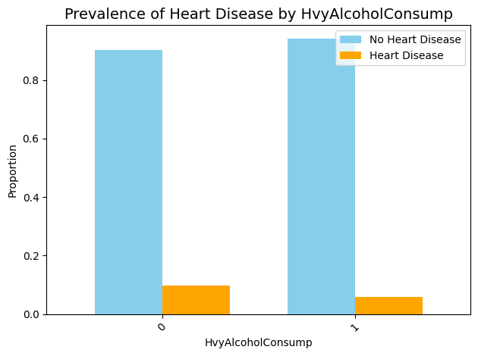
Compare Heart Disease Across Categories
Compare the prevalence of heart disease across categorical variable Heavy Alchol Consumption

Slide 67
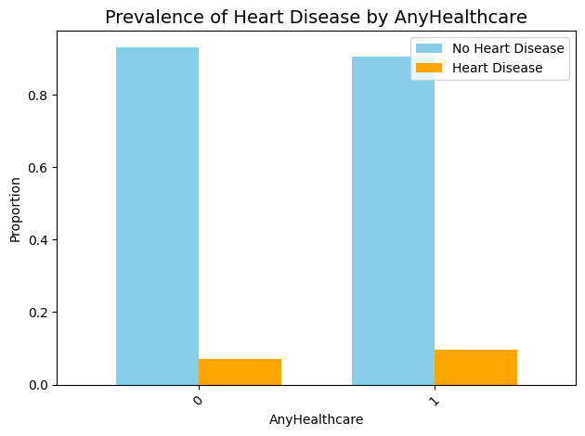
Compare Heart Disease Across Categories
Compare the prevalence of heart disease across categorical variable Any Health Carw

Slide 68
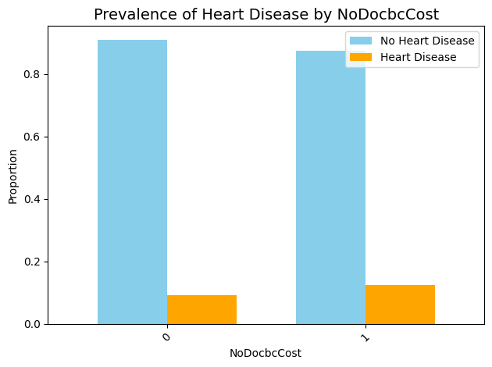
Compare Heart Disease Across Categories
Compare the prevalence of heart disease across categorical variable No Doctor Cost: Needed to see a doctor but could not

Slide 69
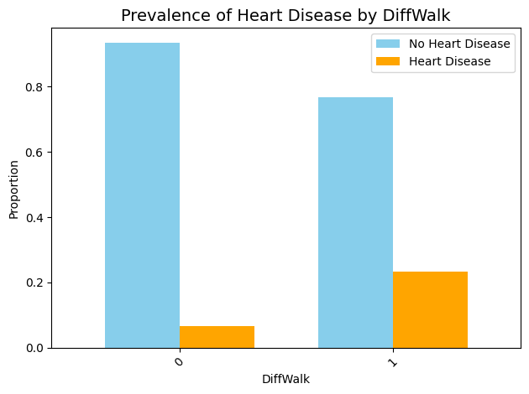
Compare Heart Disease Across Categories
Compare the prevalence of heart disease across categorical variable Difficulty in walking

Slide 70
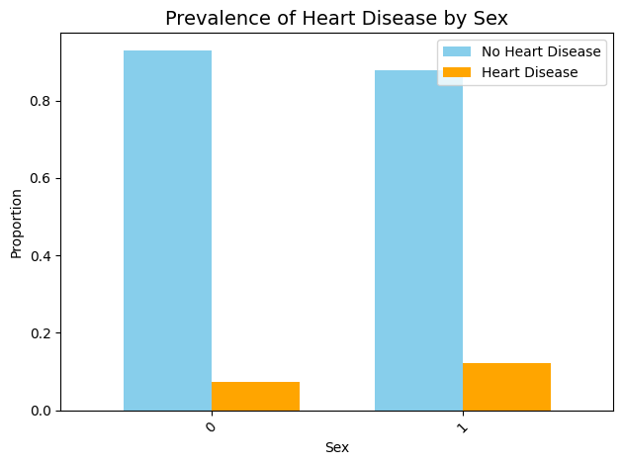
Compare Heart Disease Across Categories
Compare the prevalence of heart disease across categorical variable Sex

Slide 71
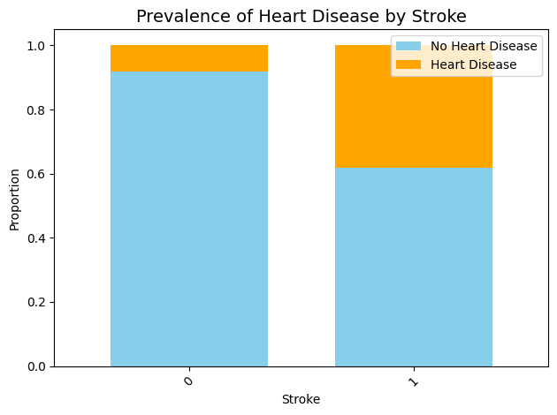
Compare Heart Disease Across Categories
Compare the prevalence of heart disease across categorical variable Stroke

Slide 72
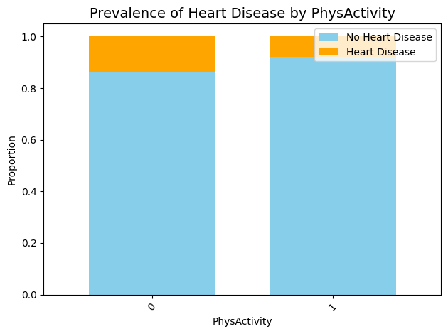
Compare Heart Disease Across Categories
Compare the prevalence of heart disease across categorical variable Physical Activity

Slide 73
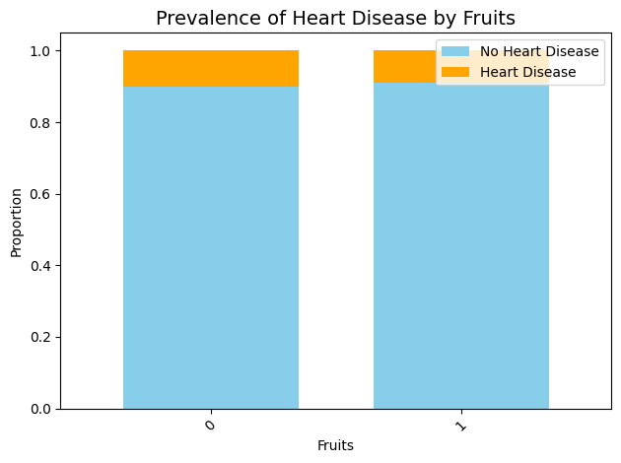
Compare Heart Disease Across Categories
Compare the prevalence of heart disease across categorical variable Fruits

Slide 74
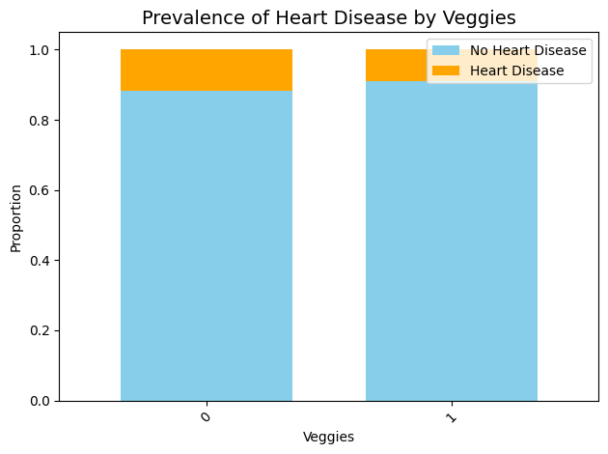
Compare Heart Disease Across Categories
Compare the prevalence of heart disease across categorical variable vegetables

Slide 75
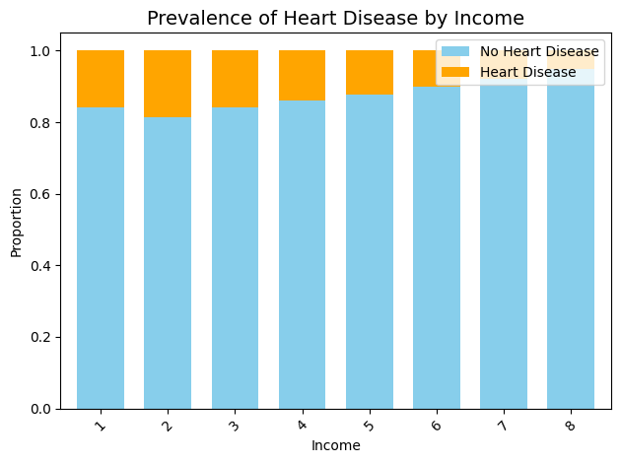
Compare Heart Disease Across Categories
Compare the prevalence of heart disease across categorical variable Income

Slide 76
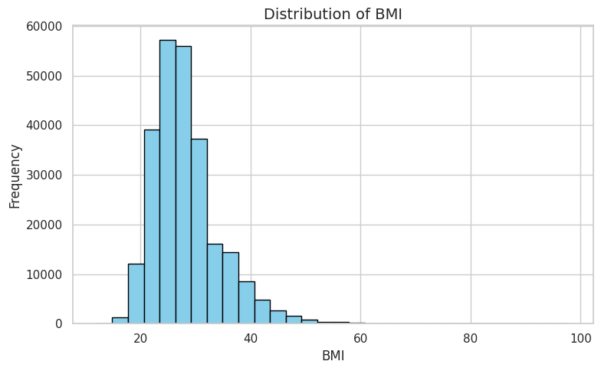
Display Distributions of Continuous Variables
Visualize the distributions of continuous variable: BMI

Slide 77
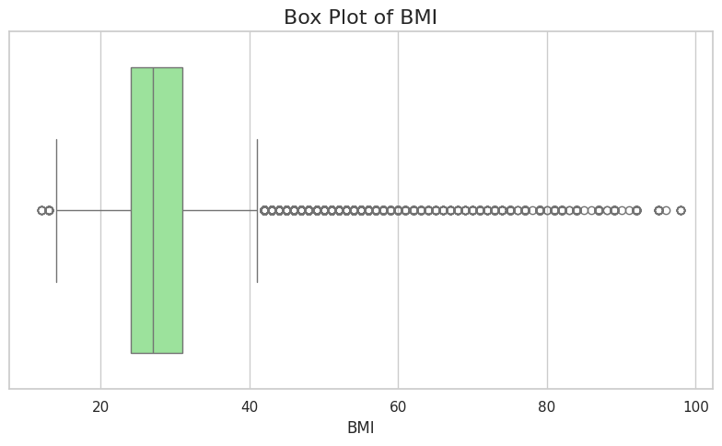
Display Distributions of Continuous Variables
Visualize the distributions of continuous variable: BMI

Slide 78
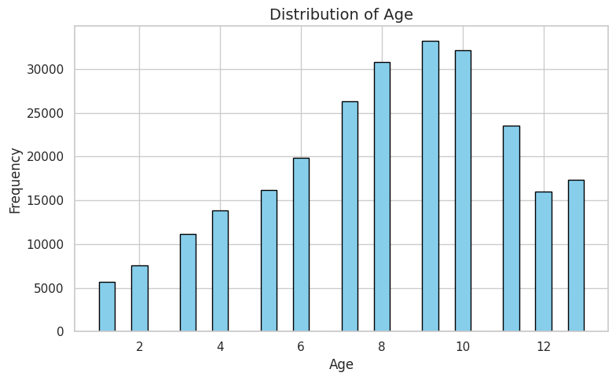
Display Distributions of Continuous Variables
Visualize the distributions of continuous variable: Age

Slide 79
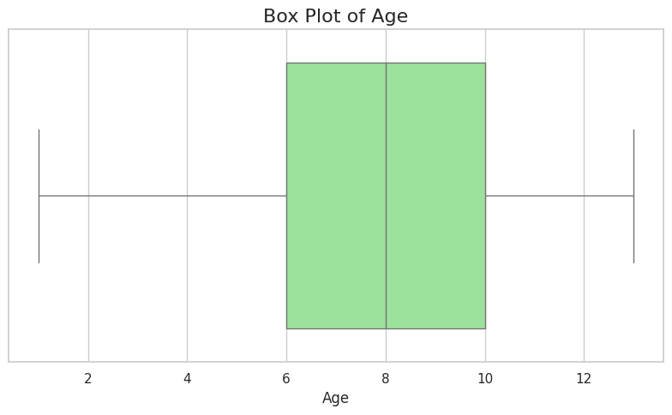
Display Distributions of Continuous Variables
Visualize the distributions of continuous variable: Age

Slide 80
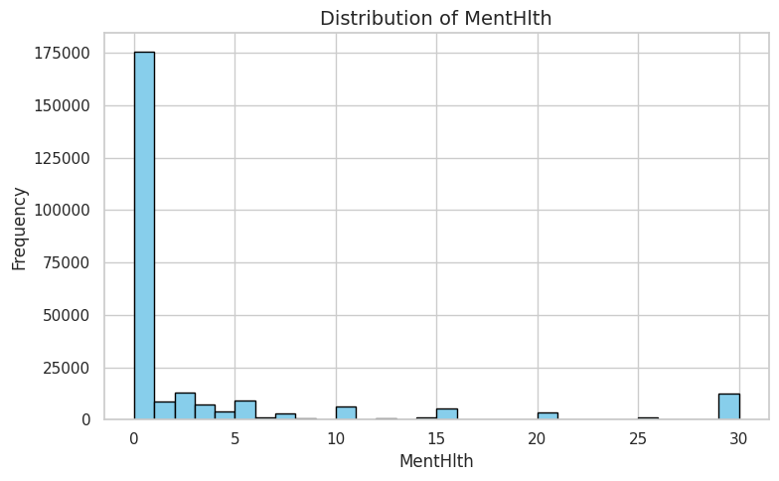
Display Distributions of Continuous Variables
Visualize the distributions of continuous variable: Mental Health

Slide 81
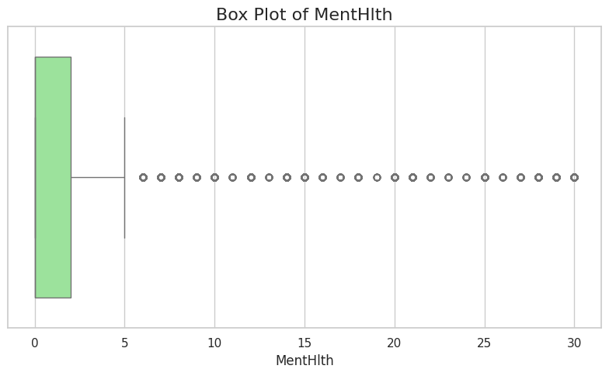
Display Distributions of Continuous Variables
Visualize the distributions of continuous variable: Mental Health

Slide 82
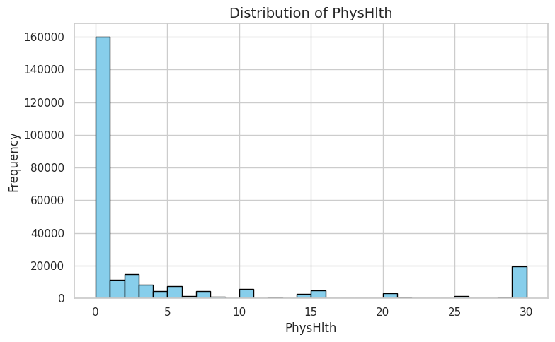
Display Distributions of Continuous Variables
Visualize the distributions of continuous variable: Physical Health

Slide 83

Display Distributions of Continuous Variables
Visualize the distributions of continuous variable: Physical Health

Slide 84

Display Distributions of Continuous Variables
Visualize the distributions of continuous variable: General Health

Slide 85

Display Distributions of Continuous Variables
Visualize the distributions of continuous variable: General Health

Slide 86

Display Distributions of Continuous Variables

Slide 87
Findings
05

Slide 88
Findings
High Blood Pressure: Individuals with high blood pressure have a significantly higher prevalence of heart disease, indicating a strong association between the two conditions.
High Cholesterol: High cholesterol is another major risk factor for heart disease, with a higher prevalence observed in individuals with elevated cholesterol levels.
Smoking: Smoking is a considerable risk factor for heart disease, as smokers have a higher prevalence of the condition compared to non-smokers.
Stroke History: A history of stroke is a major risk factor for heart disease, with a notably higher prevalence of heart disease in individuals who have had a stroke.
Diabetes: Individuals with Type 1 or Type 2 diabetes have a higher prevalence of heart disease compared to non-diabetics. Type 2 diabetes, in particular, is associated with a higher risk of heart disease.
Physical Activity: Engaging in physical activity is a protective factor against heart disease, as those who are physically active have a lower prevalence of the condition compared to those who are inactive.
Fruit and Vegetable Consumption: While there is a slight protective effect from consuming fruits and vegetables, the differences in heart disease prevalence are modest.

Slide 89
Findings
Alcohol Consumption: Heavy alcohol consumption is associated with a lower prevalence of heart disease compared to non-heavy drinkers. This could be due to moderate alcohol consumption's potential protective effects or other confounding factors.
Gender Differences: Males have a higher prevalence of heart disease compared to females, indicating a greater risk for males.
Age: Heart disease prevalence increases with age, with the risk rising significantly in older age groups.
BMI and Heart Disease:
Underweight: High prevalence of heart disease among underweight individuals, suggesting other health issues may be present.
Normal Weight: Lowest rate of heart disease observed in individuals with a normal weight, highlighting the benefits of maintaining a healthy weight.
Overweight: Higher prevalence of heart disease compared to normal weight individuals, but lower than obese individuals.
Obese: Highest rate of heart disease among obese individuals, indicating that severe overweight is detrimental to heart health

Slide 90
Conclusion
05
Protective Factors
Demographic Factors
Body Weight
Risk Factors
High blood pressure, high cholesterol, smoking, a history of stroke, and diabetes are significant risk factors for heart disease.
Among these, high blood pressure and high cholesterol are particularly notable.
Regular physical activity is a key protective factor.
Moderate fruit and vegetable consumption offers a slight benefit.
Heavy drinkers unexpectedly show lower rates of heart disease, but this doesn't mean alcohol protects the heart.
Men are at higher risk of heart disease.
Heart disease prevalence increasing significantly as individuals get older.
Underweight and obese individuals show higher rates of heart disease.
Normal weight is associated with the lowest prevalence of heart disease.

